Slide 1
Lecture 9: Floorplan – I
Tsung-Wei (TW) Huang
Department of Electrical and Computer Engineering
University of Utah, Salt Lake City, UT
Notes:
Alright, today, we are going to move on to the next topic of the physical design, floorplan. This is an early stage in the physical design to decide roughly the locations of each module you partition from the previous stage, and we want to minimize the wirelength, deadspace and so on.

Slide 2
Physical Design Flow
Notes:
This is the flowchart of the physical design we have seen multiple time. We start from the partition that breaks a big circuit into several blocks or modules, such that their interconnect length is minimized. This is what you have done in programming assignment #1.
Now, with these partitioned blocks or modules, you probably can already guess the next step is to pack them in to a rectangular area such that the resulting area is as minimum as possible and the we want to minimize the connection length among these modules as much as possible.
This is the goal of the next step, floorplan.

Slide 3
Floorplanning
I/O Pads
Floorplan
Module a
Module b
Block a
Block c
Module c
Floorplanning
GND
VDD
Block d
Block Pins
Module d
Block b
Block e
Module e
Partitioned modules (e.g., FM algorithm)
Supply Network
Notes:
Given a set of partitioned modules, you know, by running your FM to break the circuit into several pieces, the goal of floorplan is to pack these modules as close to each other as possible, and we want to minimize the complexity of interconnect between these modules and their connections to the external IO pads.
This is because ultimately, each of these modules still need to be connected to an input or an output port that are listed on the side of this chip, so they can communicate with external signals.

Slide 4
Floorplanning Problem
The floorplanning problem is to plan the positions and shapes of the modules at the beginning of the design cycle to optimize the circuit performance…
chip area
total wirelength
delay of critical path
routability
others, ex: noise, heat dissipation, …
Notes:
The problem formulation of Floorplan is as follows: we want to plan the positions and shapes of the modules (explain …)

Slide 5
Example
Given three blocks with the following potential widths & heights
Block A: w = 1, h = 4 or w = 4, h = 1 or w = 2, h = 2
Block B: w = 1, h = 2 or w = 2, h = 1
Block C: w = 1, h = 3 or w = 3, h = 1
Goal: Pack a floorplan with minimum total area enclosed
B
C
C
A
B
A
B
Floorplanning
C
A
A
Notes:
Let’s take a look at a concrete example. Given three blocks with the following potential widths & heights, Block A, B, C. Block A can have three different possible width and height combinations, as long as they result in the same area of 4. For instance, we can reshape block A to be of width 1 and height 4, or of width 4 and height 1, or of width 2 and height 2.
For block B, we can have the two possible combinations of width and height to form a rectangle of area 2. Width 1 and height 2, or in reversed, width 2 and height 1.
Similarly to C (explain …)
The goal is to pack a floorplan with minimum total area enclosed, and you can select any combinations from A, B, and C, as long as the individual area remains the same.

Slide 6
Formal Problem Formulation
Input:
n Blocks with areas A₁, ... , A_{n}
Bounds r_{i} and s_{i} on the aspect ratio of block B_{i}
Output:
Coordinates (x_{i}, y_{i}), width w_{i} and height h_{i} for each block such that h_{i} w_{i} = A_{i} and r_{i} ≤ h_{i}/w_{i} ≤ s_{i}
Objective:
To minimize the packed area and interconnect wirelength
Notes:
Let’s formally define the floorplan problem. The input is a set of n blocks with areas A1, A2, to An. We also have two bounds ri and si on the aspect ratio of block Bi, and the two bounds ask you to reshape the width and the height of a block in a way that it should be in the range of ri and si.
The output is the packed result of these n blocks, meaning that we want to know the coordinates (xi, yi), width wi and height hi for each block such that the aspect ratio of hi and wi is kept in the range of ri and si.
Of course, the objective is to optimize the the packed area and interconnect wirelength.
Question: we know we can reshape each module to a different width and height, as long as the resulting area is the same. Why do we need this constraint ri and si bounds for the aspect ratio of each module?

Slide 7
Bounds on Aspect Ratio
If there is no bound on the aspect ratios, can we pack everything tightly?
But we don’t want to layout blocks as long strips, so we require r_{i} ≤ h_{i}/w_{i} ≤ s_{i} for each module i
Floorplanning
Notes:
If there is no bound on the aspect ratios, (explain …)

Slide 8
Bounds on Aspect Ratio (cont’d)
In practice, we allow several shapes for soft blocks
For hard blocks, the orientations can be changed
E.g., rotate by 90 degree
Notes:
In practice, we allow several shapes for soft blocks. This is because at this stage, we don’t want to force too many area constraints otherwise it can become very difficult for the later stage to place cells or route wires in between. That means for software blocks you can reshape them to different widths and heights as long as the resulting area is the same.
However, there are some blocks that do not allow this, and this is the type of block we call “hard block”. For hard block, you are not allowed to change its width and height but you can rotate it by 90 degree, 180, or 270 degrees, because this does not change its area.

Slide 9
Wirelength Estimation
Exact wirelength of each net is unknown until routing
Gate-to-gate connection is routed/established via “wire”
Some possible wirelength estimations:
Center-to-center estimation
Half-perimeter wirelength (HPWL) estimation
Center-to-center
Half-perimeter wirelength
Notes:
In addition to minimizing the packed area, we want to minimize the wirelength among different modules. We know when we finish the partition, we have cut, you know, the connection between partitioned modules. This cut or connection will need to be routed through wires. That means, when we are doing floorplan, different results can give us a different wiring situation.
However, exact wirelength of each net is unknown until the routing stage is performed; you known Gate-to-gate connection is routed or established via wire, but this is not available until we move on to the routing stage.
So, we need to estimate the wirelength here. There are some possible wirelength estimations. Two popular approaches are center-to-center estimation and half-perimeter wirelength (HPWL) estimation. (explain ..)

Slide 10
Dead Space
Dead space is the space that is wasted
Minimizing area is the same as minimizing dead space
Dead space percentage is computed as
(A - Σ_{i}A_{i}) / A × 100%
Dead space (white space)
Notes:
What about area? We know one of the major goals in floorplan is to pack modules as close to each other as possible. Very often we look at this problem from another angle, the dead space, the space that is wasted in the packed result. For instance, here I have seven modules packed in a rectangular area and the blank areas here you can see, like the L-shape here, (explain …) are not filled with anything. We can them dead space or white space. This is the space that is wasted.
So, we want to minimize the packed area, and the goal is the same as minimizing dead space. So the dead space percentage is computed as follow: A is the total rectangle area in the packed result, Ai is the area of each module (explain …)

Slide 11
Objective Function
A commonly used objective function is a weighted sum of area (or dead space area) and wirelength
cost = αA + βL
A is the total area of the packing
L is the total wirelength
α and β are tuning parameters
Notes:
Now we have two objective functions, wirelength and area, to minimize. Putting them together, a commonly used objective function is a weighted sum of …

Slide 12
Formal Problem Formulation (revisited)
Input:
n Blocks with areas A₁, ... , A_{n}
Bounds r_{i} and s_{i} on the aspect ratio of block B_{i}
Output:
Coordinates (x_{i}, y_{i}), width w_{i} and height h_{i} for each block such that h_{i} w_{i} = A_{i} and r_{i} ≤ h_{i}/w_{i} ≤ s_{i}
Objective:
Minimize = αA + βL
A: total area
L: wirelength
Notes:
Now, before we move on. Any questions regarding the problem formulation?
Before we move on, let’s take a 5-10 min break and think about if I give you such a problem, how you are going to solve it. Remember the problem formulation is (explain …)
Let’s form maybe four groups to think about this, and we will come back to discuss.

Slide 13
Slicing Floorplan
Slicing floorplan
One that can be obtained by repetitively subdividing (slicing) rectangles horizontally or vertically
Non-slicing floorplan
One that may not be obtained by repetitively subdividing alone
Slicing floorplans are much easier to handle
Efficient data structures exist for efficient computational manipulations
Slicing Floorplan
Non-slicing Floorplan
Notes:
In general, we can categorize a floorplan to two types, slicing floorplan and non-slicing floorplan. Slicing floorplan is the one that can be obtained by repetitively subdividing or slicing rectangles horizontally or vertically. For example, the floorplan here is a slicing floorplan because you can slice out each module by complete vertical and horizontal cuts. (explain …)
Non-slicing floorplan is the one that may not be obtained by repetitively subdividing alone. For example, this floorplan here is a non-slicing floorplan because there is no way you can slice each module out using a complete vertical or a complete horizontal cut, iteratively.
And, which type of floorplan is easier to handle?

Slide 14
Representation of Slicing Floorplan
Slicing Floorplan
Slicing Tree
V
Q: Is slicing tree unique?
3
1
H
H
4
5
2
1
H
3
2
V
V
6
7
Polish Expression: Postorder traversal of the slicing tree
6
7
4
5
21H67V45VH3HV
Notes:
So let’s deal with the easy type of floorplan first, the slicing floorplan. Because of the special property, you know, each module can be sliced out vertically or horizontally, we can represent this process using a slicing tree. A slicing tree is a binary tree that all the internal nodes are V or H operations while the leaf nodes are modules. We know a binary tree is a data structure that each node has at most two children nodes.
This is the binary tree that represents this slicing floorplan. Each internal node represents a cut, either vertical cut or horizontal cut. If I apply a vertical cut, we can see left subtrees contain the modules to the left of the cut, and the right subtree contain the modules to the right of the cut. In this case, modules 1 and 2 are to the left of the cut, and modules 3, 4, 5, 6, and 7 are to the right of the cut.
On the other hand, if I apply a horizontal cut, we can see left subtrees contain the modules below the cut and the right subtrees contain the modules above the cut. (explain …)
So, by doing this recursively, we can construct a slicing tree for a slicing floorplan. (explain polish expression.)

Slide 15
Slicing Tree is NOT Unique
Two possible slicing trees representing the same floorplan
V
V
c
H
H
H
H
b
e
f
a
b
c
H
Alternatively …
a
b
d
H
a
d
d
V
c
V
e
f
e
f

Slide 16
Polish Expression
Succinct representation of slicing floorplan
Roughly specifies relative positions of blocks
Postorder traversal of slicing tree algorithm (recursive)
1. Call postorder traversal of left sub-tree
2. Call postorder traversal of right sub-tree
3. Print the label of the current root
For n blocks, a Polish Expression contains n operands (blocks) and n-1 operators (H, V)
However, for a given slicing floorplan, the corresponding slicing tree (and hence polish expression) is not unique. Therefore, there is some redundancy in the representation
Notes:
With a slicing tree in place, we can represent it using a polish expression. A polish expression is a succinct representation of slicing floorplan which roughly specifies relative positions of blocks. To derive a polish expression from a slicing tree, we can perform a postorder traversal of the slicing tree, and this is a simple recursive program as follows: (explain …)
Essentially, a post order traversal is a specialized depth-first-search on a tree data structure that you will not print out your parent recursion until you finish the traversal of the two subchildren.
For n blocks, (explain the following two items …)

Slide 17
Redundancy of Polish Expression
Recall that the slicing tree representation is not unique
V
V
3
1
H
H
H
H
4
5
2
1
H
3
2
1
V
H
V
V
6
7
V
3
2
6
7
6
7
4
5
4
5
21H67V45VH3HV
21H67V45V3HHV
Notes:
Let’s take a look again at the redundancy of polish expression. (explain …)

Slide 18
Skewed and Normalized Slicing Tree
Skewed Slicing Tree: no node and its right child are the same
Normalized Polish Expression: no consecutive H’s or V’s
Skewed slicing tree
(also normalized)
Not normalized!
V
V
3
1
H
H
H
H
4
5
2
1
H
3
2
1
V
H
V
V
6
7
V
3
2
6
7
6
7
4
5
4
5
21H67V45VH3HV
21H67V45V3HHV
Notes:
To avoid the redundancy, we can impose two constraints on the polish expression. The first constraint is skewed slicing tree. This is a slicing tree that no nodes and its right child are the same. The second constraint is normalized polish expression. This is a slicing tree that no consecutive H or V can be found.
Let’s take a look at this example, a skewed slicing tree. Why? (explain …) This tree is also normalized because you cannot find consecutive H or V in the tree.

Slide 19
Normalized Polish Expression
There is a 1-1 correspondence between Slicing Floorplan, Skewed Slicing Tree, and Normalized Polish Expression
We can use valid Normalized Polish Expression (NPE) to represent slicing floorplans
We formulate as a state space search problem
Notes:
Why do we care normalized polish expression? (explain …)

Slide 20
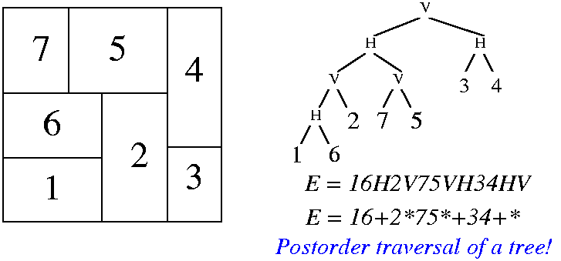
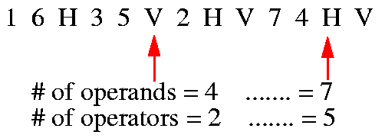
Solution Representation
An expression E = e₁e₂…e_{2n-1}, where e_{i} ∈ {1, 2, …, n, H, V}, 1≤i ≤2n-1, is a valid Polish expression of length 2n-1 if
every operand j, 1 ≤ j ≤n, appears exactly once in E;
for every sub-expression E_{i} = e₁…e_{i}, 1≤ i ≤2n-1, #operands > #operators.
Polish expression ↔ Postorder traversal.
ijH: i below j; ijV: i on the left of j.
Notes:
Let’s formally define what a valid polish expression is, and we can modify it to be normalized or skewed because their properties are in fact quite straightforward.
An expression E equal to e1 e2, … e2n-1, where ei can be either a module or a cut H or V. The expression is a vlid polish expression if (explain …)
And we know polish expression can be derived from a slicing tree using a postorder traversal. If I have ij H that means I is below j. If I have ijV, that means I is on the left of j.
Let’s take a look at this polish expression example, 16H35V (explain the direction ijH …)

Slide 21
Example
12VH3: invalid
123VH: valid
1234567HHHHVV: valid
1HVVHHV743526: invalid
Notes:
Let’s look at some examples of valid and invalid polish expressions. Is the first expression valid or not? (explain …)

Slide 22
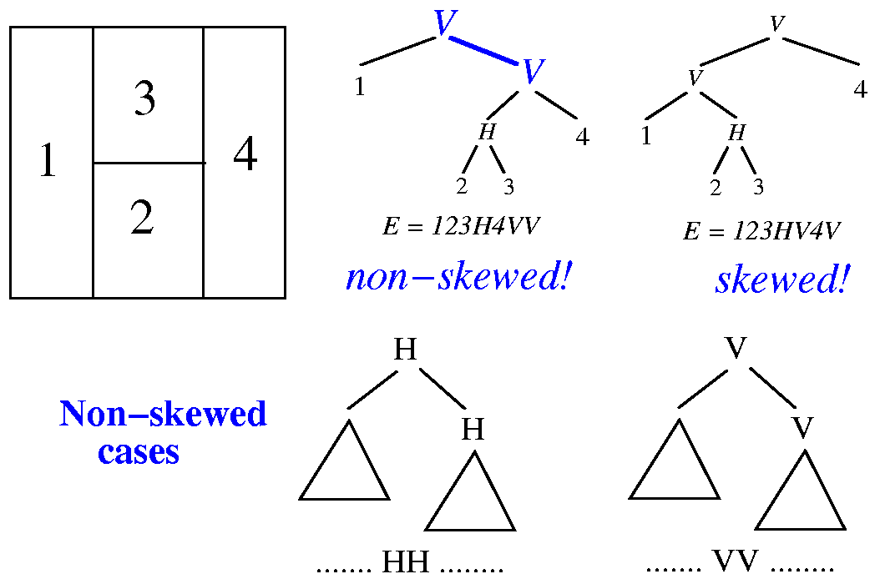
How to Remove Redundant Rep?
Notes:
Remember we have talked about such a representation is not unique. For a slicing floorplan, we can have multiple slicing tree representing its layout. And we can remove such redundancy by adding two constraints, making it skewed and normalized.
Let’s takin a look at these examples (explain …)
Now, if you want to manipulate the two constraints, making a tree skewed and normalized, directly on the slicing tree, it’s actually quite difficult, because you need to relink the tree and redirect the pointer data structure.
However, this process can be largely simplified at the polish expression, because it is just 1D operation. For instance, if I have an expression 123H4VV, which is non-skewed because it has two consecutive Vertical cuts, then we can move a module like 4 in between to make it nonskewed! Doing this operation on the expression is much easier than on a 2D tree, right?

Slide 23
Neighborhood Structure
Chain: HVHVH… or VHVHV…
The moves:
M1: Swap adjacent operands (ignoring chains)
M2: Complement some chain
M3: Swap 2 adjacent operand and operator
M3 can give you some invalid NPE. Checking for validity after M3 is needed
It can be proved that every pair of valid NPE are connected
16H35V2HV74HV
Chains
Notes:
Now this becomes a state search problem, given an initial expression, can we iteratively modify it to become a result of minimum area. We can apply three possible modification or moves to change the expression, and keep in mind, each expression gives you a different 2D layout. Kindof amazing right, now we transform a 2D optimization problem into a 1D representation and 1D search problem.
The three possible moves are: (explain …)

Slide 24
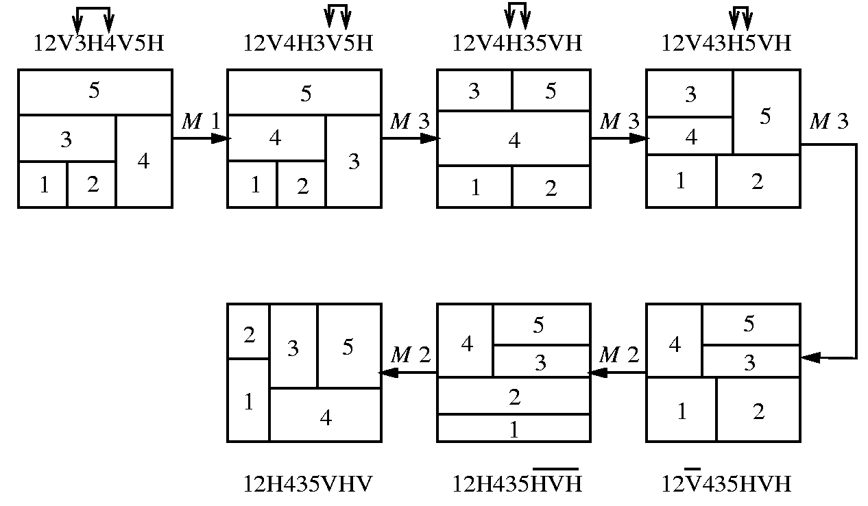
Example of Moves
1
Each move gives a new floorplan result
Key idea: try out many moves and acquire the best solution?
1
M1
2
4
5
5
3
4
3
2
34V2H5V1H
32V4H5V1H
M3
1
1
4
5
5
M2
3
2
3
2
4
32V45VH1H
32V45HV1H
Notes:
Let’s take a look at a floorplan example and how the three moves change the layout. Here I have an initial floorplan, sliceable with the polish expression 34V2H5V1H. We apply move 1 to swap two modules 4 and 2 (explain …)
Now you probably can see how amazing this 1D expression can do for us. Each move gives a new floorplan result, right? And the key idea here is to try out many moves and acquire the best solution using efficient method.

Slide 25
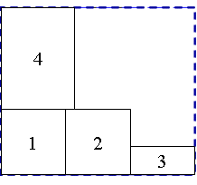
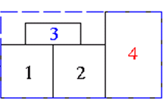
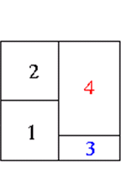
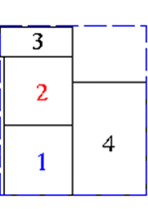
Example of Moves (cont’d)
Optimal result is acquired after three moves, M1, M2, and M3
M1
12V4H3V
12V3H4V
Initial State
M1
M2
New solution 1
M2
New solution 2
Can we solve this systematically?
M3
M3
New solution 2
…
12H34HV
12H3H4V
Notes:
So, how do we solve this systematically?

Slide 26
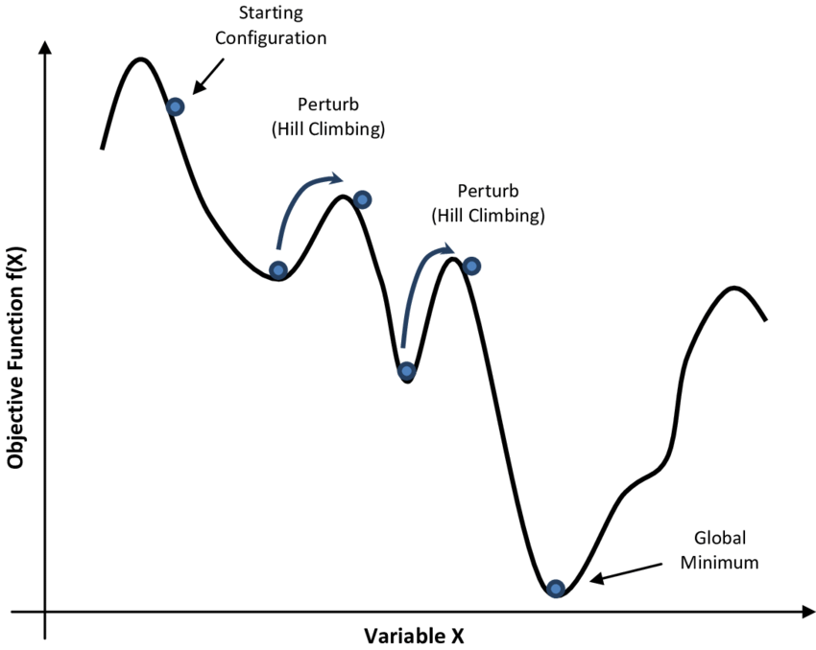
Simulated Annealing (SA) Algorithm
1 begin
2 Get an initial solution S;
3 Get an initial temperature T > 0;
4 while not yet “frozen” do
5 for 1 i P do
6 Pick a random neighbor S’ of S;
7 △← cost(S’) – cost(S); /* down hill move */
8 if △ 0 then S←S’ /* uphill move */
9 if △ > 0 then S←S’ with probability;
10 T←rT ; /* reduce temperature */
11 return S
12 end
cost (S)
State S
Notes:
Well, this type of state search problem is particularly useful for simulated annealing, right? Remember the pseudocode of simulated annealing or SA, we start with an initial solution and proceed to a high temperature of annealing. At each of the temperature iteration, (explain …)

Slide 27
SA-based Floorplan Optimization
T_{i} = αT_{i-1} where α=0.85
At each temperature, try k × n moves
k is around 5 to 10
Terminate the annealing process if
either # of accepted moves < 5%
or the temperature is low enough
Cost metric: αA + βL
Area + Wirelength
Initial State: 1V2V3V…nV
2
3
....
n
1
Notes:
We can apply SA to solve the floorplan or precisely, slicing floorplan using the slicing tree and its polish expression. We start with an initial state which can be arbitrary organized, like 1V2V3..nV. (explain …)

Slide 28
Result of SA-based Floorplan
Notes:
This slide shows the result of SA-based floorplan. On the figure here, we see the number of moves vs the number of iterations. On the figure below, we see the cost function is decreasing as the number of iterations increases. And this SA-based floorplan optimization can actually give us a very good result in terms of the final cost value.

Slide 29
How Do We Know the Area from a PE?
Binary operator: V and H
V: maximum on width and summation on height
H: maximum on height and summation on width
W₁₂
2
W₃₄
H
H₁₂
V
1
H₃₄
3
1
2
4
3
4
W₁₂= max(W₁ , W₂)
H₁₂= H₁ + H₂
W₃₄ = W₃ + W₄
H₃₄ = max(H₃ , H₄)
(a) Postfix expression: 12H
(b) Postfix expression: 34V
Notes:
There is another key question we havn’t answered yet. (explain …)

Slide 30
Recover Area Recursively
Binary operator: V and H
V: maximum on width and summation on height
H: maximum on height and summation on width
Bottom-up merging left and right subtrees
W₁₂₃₄
V
2
H₁₂₃₄
H
V
1
3
4
1
2
3
4
W₁₂₃₄ = W₁₂ + W₃₄
H₁₂₃₄ = max(H₁₂ , H₃₄)
(c) Postfix expression: 12H34VV
Notes:
With this idea, we can recover the area recursively. Each subtree is essentially a slicing floorplan and we can use the whole floorplan or rectangle representing that slicing floorplan during the packing process. (repeat and then explain …)

Slide 31
Recover Area Recursively (cont’d)
Binary operator: V and H
V: maximum on width and summation on height
H: maximum on height and summation on width
Bottom-up merging left and right subtrees
W₁₂₃₄
H
3
4
H
V
2
H₁₂₃₄
1
2
3
4
1
(d) Postfix expression: 12H34VH
W₁₂₃₄ = max(W₁₂ + W₃₄)
H₁₂₃₄ = H₁₂ + H₃₄

Slide 32
Implementation using Stack
Very similar to the parathesis checking problem
Modification
Number: push the module into the stack
V/H: pack the top-two blocks (subtrees) vertically/horizontally
Notes:
How do we implement this?

Slide 33
How do We Handle Non-Slicing Floorplan?
Extend NEP to include pre-defined non-slicing block
d
H
b
e
g
V
H
c
a
f
H
W
h
i
H
h
i
a
b
c
d
e
f
g
H
Horizontal division (objects to the top and bottom)
H
W
Wheel (4 objects cycled around a center object)
Vertical division (objects to the left and right)
H
V
H
Notes:
How do we handle non-slicing floorplan?

Slide 34
Summary
Floorplan problem is NP hard (difficult to solve efficiently)
How to represent it compactly is a big deal
Slicing is easier to deal with, so let’s start with it
Next lectures will cover other representations
Polish expression is an elegant slicing-tree representation
Need to be unique (NPE) to remove redundant space
Can be implemented efficient using linear-time data structure
Simulated annealing algorithm fits well to floorplan
Optimize the floorplan area and wirelength simultaneously

